Slide 1
Software Engineering
Design Patterns
CS 1530
Spring 2020
Instructor: Sohel Sarwar
University of Pittsburgh
Lecture 11

Slide 2
DESIGN PATTERN
(Adapter, Bridge, Facade )

Slide 3
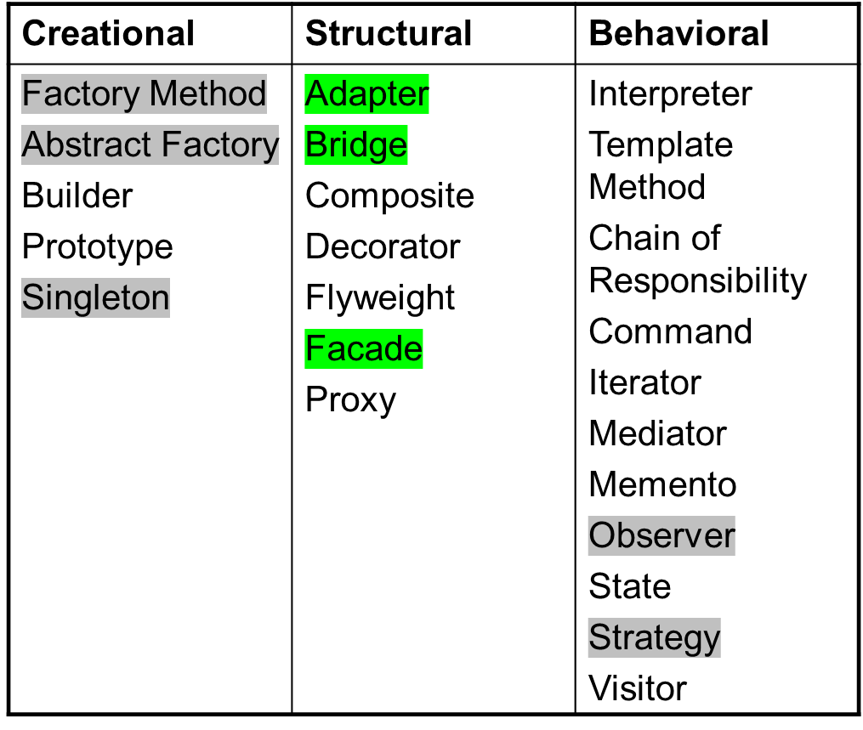
Recap
Classification of GoF Design Pattern
© E. Gamma, R. Helm, R. Johnson, J. Vlissides and Addison-Wesley

Slide 4
Adapter
Adapter pattern works as a bridge between two incompatible interfaces. This type of design pattern comes under structural pattern as this pattern combines the capability of two independent interfaces.

Slide 5
Adapter
This pattern involves a single class which is responsible to join functionalities of independent or incompatible interfaces. A real-life example could be a case of card reader which acts as an adapter between memory card and a laptop. You plugin the memory card into card reader and card reader into the laptop so that memory card can be read via laptop.

Slide 6
Adapter (cont.)
class NewTime
{
public:
int GetTime() {
return m_oldtime.get_time() * 1000 + 8;
}
private:
OldTime m_oldtime;
};

Slide 7
Adapter Motivation
Situation:
  You have some code you want to use for a program
  You can’t incorporate the code directly (e.g. you just have the .class file, say as part of a library)
  The code does not have the interface you want
    Different method names
    More or fewer methods than you need
To use this code, you must adapt it to your situation
CMSC 433, Fall 2002

Slide 8
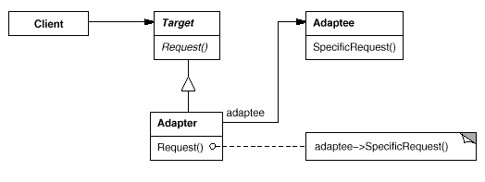
Adapter pattern
Clients needs a target that implements one interface
CMSC 433, Fall 2002

Slide 9
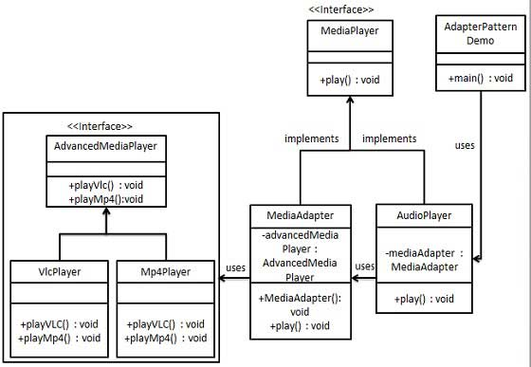
Adapter

Slide 10
Adapter
Implementation
We have a MediaPlayer interface and a concrete class AudioPlayer implementing the MediaPlayer interface. AudioPlayer can play mp3 format audio files by default.
We are having another interface AdvancedMediaPlayer and concrete classes implementing the AdvancedMediaPlayer interface. These classes can play vlc and mp4 format files.

Slide 11
Adapter
Implementation
We want to make AudioPlayer to play other formats as well. To attain this, we have created an adapter class MediaAdapter which implements the MediaPlayer interface and uses AdvancedMediaPlayer objects to play the required format.
AudioPlayer uses the adapter class MediaAdapter passing it the desired audio type without knowing the actual class which can play the desired format. AdapterPatternDemo, our demo class will use AudioPlayer class to play various formats.

Slide 12
Adapter
Step 1
//Create interfaces for Media Player and Advanced Media //Player: MediaPlayer.java
public interface MediaPlayer {
public void play(String audioType, String fileName);
}
AdvancedMediaPlayer.java
public interface AdvancedMediaPlayer {
public void playVlc(String fileName);
public void playMp4(String fileName);
}

Slide 13
Adapter
//Step 2: Create concrete classes implementing the //AdvancedMediaPlayer interface: VlcPlayer.java
public class VlcPlayer implements AdvancedMediaPlayer{
@Override
public void playVlc(String fileName) {
System.out.println("Playing vlc file. Name: "+ fileName);
}
@Override
public void playMp4(String fileName) {
//do nothing
}
}

Slide 14
Adapter
// Step 2: Create Mp4Player.java
public class Mp4Player implements AdvancedMediaPlayer{
@Override
public void playVlc(String fileName) {
//do nothing
}
@Override
public void playMp4(String fileName) {
System.out.println("Playing mp4 file. Name: "+ fileName);
}
}

Slide 15
Adapter
// Step 3: Create adapter class implementing the MediaPlayer interface: MediaAdapter.java
public class MediaAdapter implements MediaPlayer {
AdvancedMediaPlayer advancedMusicPlayer;
public MediaAdapter(String audioType){
if(audioType.equalsIgnoreCase("vlc") ){
advancedMusicPlayer = new VlcPlayer();
}else if (audioType.equalsIgnoreCase("mp4")){
advancedMusicPlayer = new Mp4Player();
}
}

Slide 16
Adapter
// Step 3: Create adapter class implementing the MediaPlayer interface: MediaAdapter.java
@Override
public void play(String audioType, String fileName) {
if(audioType.equalsIgnoreCase("vlc")){
advancedMusicPlayer.playVlc(fileName);
}
else if(audioType.equalsIgnoreCase("mp4")){
advancedMusicPlayer.playMp4(fileName);
}
}
}

Slide 17
Adapter
Step 4
Create concrete class implementing the MediaPlayer interface.
AudioPlayer.java
public class AudioPlayer implements MediaPlayer {
MediaAdapter mediaAdapter;
@Override
public void play(String audioType, String fileName) {
//inbuilt support to play mp3 music files
if(audioType.equalsIgnoreCase("mp3")){
System.out.println("Playing mp3 file. Name: " + fileName);
}

Slide 18
Adapter
//Step 4: Create concrete class implementing the MediaPlayer interface: AudioPlayer.java
//mediaAdapter is providing support to play other file formats
else if(audioType.equalsIgnoreCase("vlc") || audioType.equalsIgnoreCase("mp4")){
mediaAdapter = new MediaAdapter(audioType);
mediaAdapter.play(audioType, fileName);
}
else{
System.out.println("Invalid media. " + audioType + " format not supported");
}
}
}

Slide 19
Adapter
Step 5
Use the AudioPlayer to play different types of audio formats.
AdapterPatternDemo.java
public class AdapterPatternDemo {
public static void main(String[] args) {
AudioPlayer audioPlayer = new AudioPlayer();
audioPlayer.play("mp3", "beyond the horizon.mp3");
audioPlayer.play("mp4", "alone.mp4");
audioPlayer.play("vlc", "far far away.vlc");
audioPlayer.play("avi", "mind me.avi");
}
}

Slide 20
DESIGN PATTERN
Bridge

Slide 21
Applicability
Selection or switching of implementation is at run-time rather than design time.
Abstraction and implementation should both be extensible by subclassing.
You want to isolate implementation changes from clients.
You want to share an implementation among multiple objects and this should be hidden from the client.

Slide 22
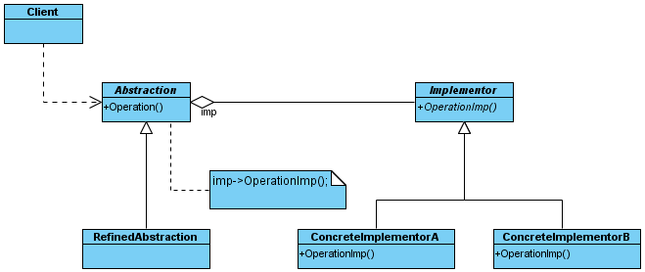
Pattern Structure
bridge

Slide 23
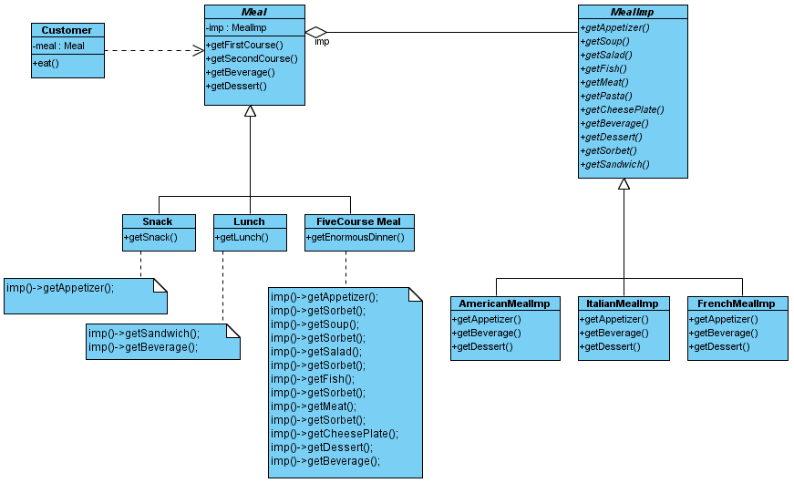
A Meal Example
bridge

Slide 24
Code – 1 of 1 (Abstraction)
public class Meal {
protected MealImp imp;
public Meal() {
imp = new AmericanMealImp();
}
public Meal(String type) {
if (type.equals("American"))
imp = new AmericanMealImp();
if (type.equals("Italian"))
imp = new ItalianMealImp();
if (type.equals("French"))
imp = new FrenchMealImp();
}
public void getFirstCourse() {
imp.getAppetizer();
}
public void getSecondCourse() {
imp.getMeat();
}
public void getBeverage() {
imp.getBeverage();
}
public void getDessert() {
imp.getDessert();
}
}
public class Snack extends Meal {
public void getSnack() {
imp.getAppetizer();
}
}
public class FiveCourseMeal extends Meal {
public void getEnormousDinner() {
imp.getAppetizer();
imp.getSorbet();
imp.getSoup();
imp.getSorbet();
imp.getSalad();
imp.getSorbet();
imp.getFish();
imp.getSorbet();
imp.getMeat();
imp.getSorbet();
imp.getCheesePlate();
imp.getDessert();
imp.getBeverage();
}
}
public class Lunch extends Meal {
public void getLunch() {
imp.getSandwich();
imp.getBeverage();
}
}

Slide 25
Code – 2 of 2 (Implementor)
public interface MealImp {
public abstract void getAppetizer();
public abstract void getSoup();
public abstract void getSalad();
public abstract void getFish();
public abstract void getMeat();
public abstract void getPasta();
public abstract void getCheesePlate();
public abstract void getBeverage();
public abstract void getDessert();
public abstract void getSorbet();
public abstract void getSandwich();
}
public class ItalianMealImp implements MealImp {
public void getAppetizer() {
System.out.println("Appetizer: anti pasti"); }
public void getSoup() {}
public void getSalad() {}
public void getFish() {}
public void getMeat() {
System.out.println("Meat: chicken piccata"); }
public void getPasta() {}
public void getCheesePlate() {}
public void getBeverage() {
System.out.println("Beverage: cappuccino"); }
public void getDessert() {
System.out.println("Dessert: gelato"); }
public void getSorbet() {}
public void getSandwich() {}
}
public class AmericanMealImp implements MealImp {
public void getAppetizer() {
System.out.println("Appetizer: nachos"); }
public void getSoup() {}
public void getSalad() {}
public void getFish() {}
public void getMeat() {
System.out.println("Meat: steak"); }
public void getPasta() {}
public void getCheesePlate() {}
public void getBeverage() {
System.out.println("Beverage: beer"); }
public void getDessert() {
System.out.println("Dessert: apple pie"); }
public void getSorbet() {}
public void getSandwich() {}
}
public class FrenchMealImp implements MealImp {
public void getAppetizer() {
System.out.println("Appetizer: escargot"); }
public void getSoup() {}
public void getSalad() {}
public void getFish() {}
public void getMeat() {
System.out.println("Meat: coq au vin"); }
public void getPasta() {}
public void getCheesePlate() {}
public void getBeverage() {
System.out.println("Beverage: bordeaux"); }
public void getDessert() {
System.out.println("Dessert: creme brulee"); }
public void getSorbet() {}
public void getSandwich() {}
}

Slide 26
Code – 3 of 3 (Client)
public class Customer {
private Meal meal;
public Customer(Meal aMeal) { meal = aMeal; }
public void eat() {
meal.getFirstCourse();
meal.getSecondCourse();
meal.getBeverage();
meal.getDessert();
}
public static void main(String[] args) {
Meal aMeal = null;
// Read the input to see if we do American, Italian or French
if (args.length == 0) {
// create default Meal
aMeal = new Meal();
}
else if (args.length == 1) {
// see if arg is NOT American, Italian or French
if (!(args[0].equals("American")) && !(args[0].equals("Italian")) && !(args[0].equals("French"))) {
System.err.println("1 arg given but not recognized");
System.err.println("usage: java Customer [American|Italian|French]");
System.exit(1);
}
else {
aMeal = new Meal(args[0]);
}
}
else { // error
System.err.println("wrong number of args");
System.err.println("usage: java Customer [American|Italian|French]");
System.exit(1);
}
Customer c = new Customer(aMeal);
c.eat();
}
}

Slide 27
Code - Results
Bob@Bob-XPS ~/cspp51023/Bridge Pattern
$ java Customer American
Appetizer: nachos
Meat: steak
Beverage: beer
Dessert: apple pie
Bob@Bob-XPS ~/cspp51023/Bridge Pattern
$ java Customer Italian
Appetizer: anti pasti
Meat: chicken piccata
Beverage: cappuccino
Dessert: gelato
Bob@Bob-XPS ~/cspp51023/Bridge Pattern
$ java Customer French
Appetizer: escargot
Meat: coq au vin
Beverage: bordeaux
Dessert: creme brulee
Bob@Bob-XPS ~/cspp51023/Bridge Pattern
$

Slide 28
Consequences
Decouples interface and implementation.
  Eliminates compile-time dependencies.
Improved extensibility.
Hiding implementation details from client.

Slide 29
Implementation Considerations
Only one Implementor
  Multiple implementors not always needed.
  Separation is still useful even in this degenerate case to hide implementation changes from clients.
Creating correct Implementor
  Instantiate in constructor based on parameters.
  Use default implementation and possibly change later.
  Use AbstractFactory.
Sharing Implementors
  Use a reference count in the implementation to know when an instance is being used.

Slide 30
Related Patterns
Abstract Factory -
Used to create the Implementor and remove all knowledge of which one from the Abstraction.
Adapter –
Used to make 2 unrelated classes work together. Usually applied after system is designed. Bridge does similar work but is done up front during design.

Slide 31
DESIGN PATTERN
Façade

Slide 32
Facade – What?
Provide a unified interface to a set of interfaces in a subsystem.
Defines a high level interface that makes the subsystem easier to use.

Slide 33
Facade – Why?
Problem:
Need for a simplified interface to the overall functionality of a complex system.
Motivation:
Reduce Complexity: Introduce a façade object that provides a single, simplified interface to a more general facilities of a subsystem.

Slide 34
Façade
Applicability
Use the facade pattern when you want to provide a simple interface to a complex system.
You want to layer your subsystem
Consequences
Shielding clients from subsystem promotes weak coupling b/w subsystem and the clients.
Simplifies porting systems to other platforms.
Liabilities
Does not prevent clients from accessing the underlying classes.

Slide 35
Façade
Façade
© E. Gamma, R. Helm, R. Johnson, J. Vlissides and Addison-Wesley

Slide 36
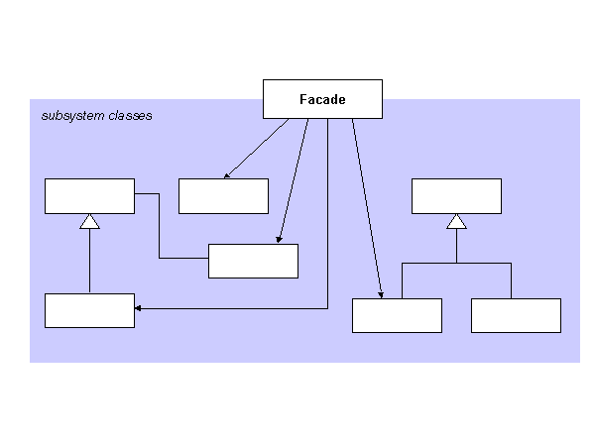
Facade - Structure

Slide 37
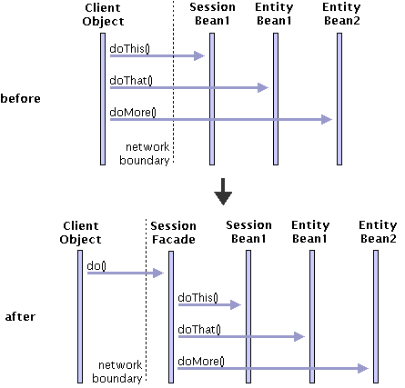
Façade

Slide 38
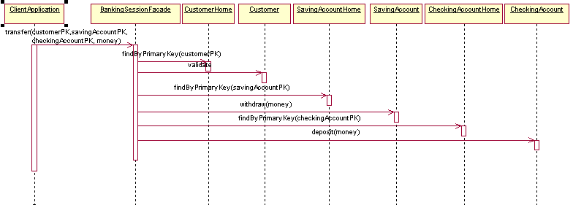
Façade - Example

Slide 39
Facade - Participants
Façade
Implements subsystem functionality
Knows which subsystem classes are responsible for a request.
Delegates client requests to appropriate subsystem objects
Handles work assigned by the façade object
Has know knowledge of the façade

Slide 40
Facade - Implementation
Reduces client subsystem coupling
Provides an abstract coupling between the façade abstract class and the concrete subclasses for different implementation of a subsystem.
Public vs. Private subsystem classes
Subsystem is analogous to a class in that a class encapsulates state and operations, while a subsystem encapsulates classes.
The public interface of a system consists of classes that all clients can access.
Private interface is just for subsystem extenders.
The Façade class is part of the public interface, but not only part of it, other subsystem classes are also usually public.
Just like using name spaces in C++ to make subsystem classes private.

Slide 41
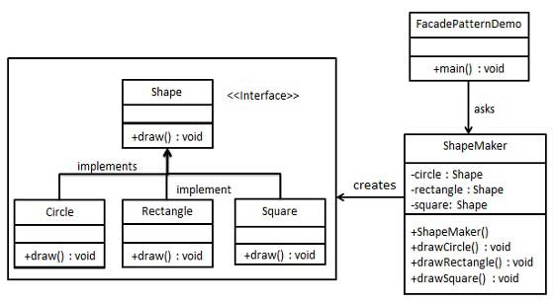
Facade - Implementation

Slide 42
Facade - Implementation
Step 1
//Create an interface: Shape.java
public interface Shape {
void draw();
}

Slide 43
Facade - Implementation
Step 2
//Create concrete classes implementing the same interface.
//Rectangle.java
public class Rectangle implements Shape {
@Override
public void draw() {
System.out.println("Rectangle::draw()");
}
}

Slide 44
Facade - Implementation
Step 2
//Create concrete classes implementing the same interface.
// Square.java
public class Square implements Shape {
@Override
public void draw() {
System.out.println("Square::draw()");
}
}

Slide 45
Facade - Implementation
Step 2
//Create concrete classes implementing the same interface.
// Circle.java
public class Circle implements Shape {
@Override
public void draw() {
System.out.println("Circle::draw()");
}
}

Slide 46
Facade - Implementation
Step 3
//Create a facade class.
ShapeMaker.java
public class ShapeMaker {
private Shape circle;
private Shape rectangle;
private Shape square;
public ShapeMaker() {
circle = new Circle();
rectangle = new Rectangle();
square = new Square();
}

Slide 47
Facade - Implementation
Step 3 Continued…
//Create a facade class.
//ShapeMaker.java
public void drawCircle(){
circle.draw();
}
public void drawRectangle(){
rectangle.draw();
}
public void drawSquare(){
square.draw();
}
}

Slide 48
Facade - Implementation
Step 4
//Use the facade to draw various types of shapes.
FacadePatternDemo.java
public class FacadePatternDemo {
public static void main(String[] args) {
ShapeMaker shapeMaker = new ShapeMaker();
shapeMaker.drawCircle();
shapeMaker.drawRectangle();
shapeMaker.drawSquare();
}
}

Slide 49
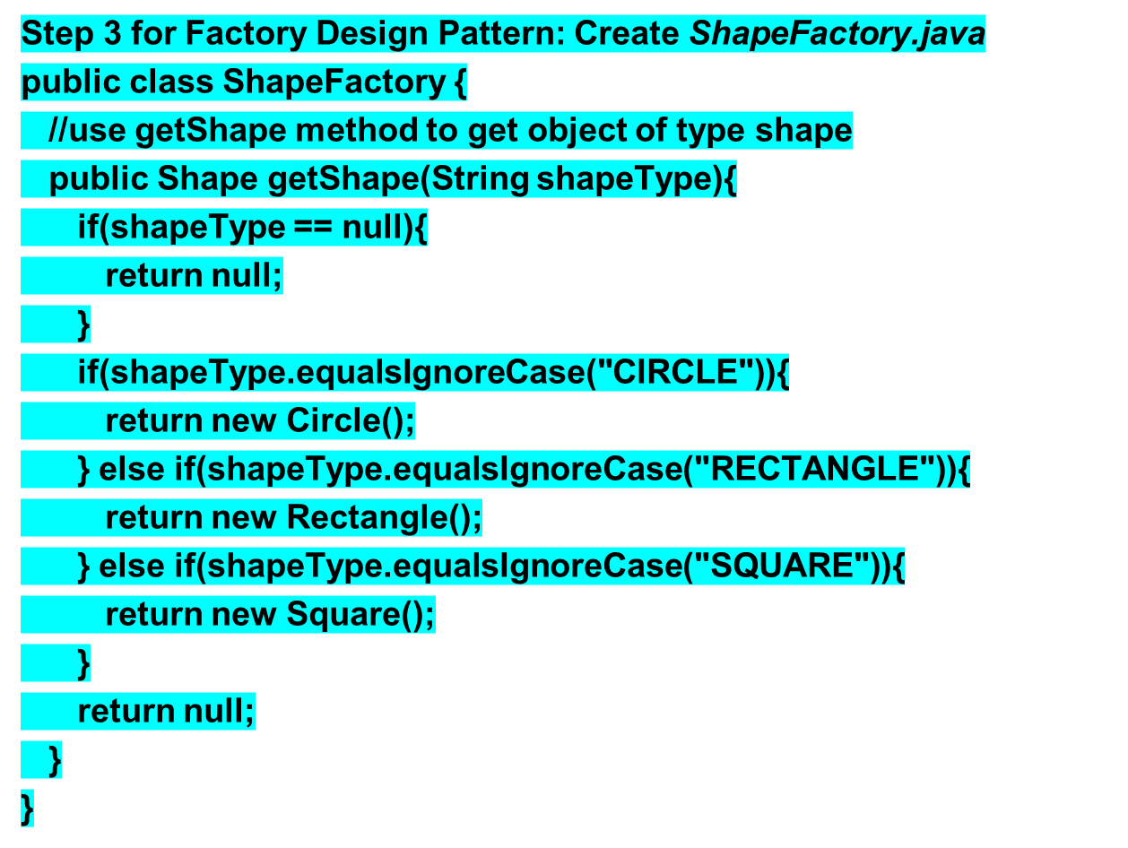
Factory Design Pattern Implementation
Just for Reference

Slide 50
Anti-Patterns

Slide 51
Anti-Patterns
Antipatterns are common solutions to common problems where the solution is ineffective and may result in undesired consequences.
An antipattern is different from bad practice when:
  It is a common practice that initially looks like an appropriate solution, but eventually have bad consequences that outweigh any benefits
  There’s another solution that is known, repeatable, and effective.
  The concept of antipatterns was inspired by the concept of design patterns, which indicate common effective solutions to common problems.

Slide 52
Anti-Patterns
1995 Andrew Koenig originally coined the term antipattern in the March - April 1995 edition of the Journal of Object Oriented Program: “An antipattern is just like a pattern, except that instead of a solution it gives something that looks superficially like a solution, but isn’t one.”

Slide 53
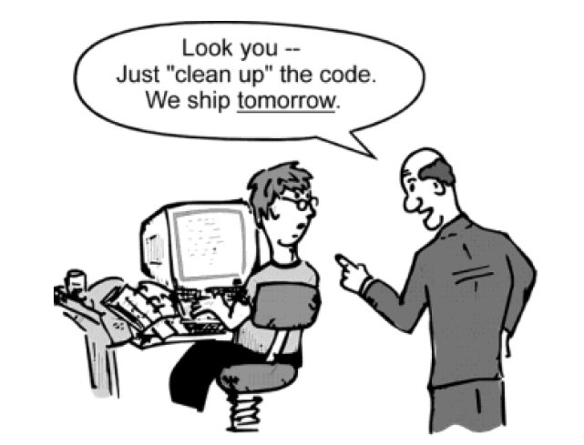
Root Cause of Anti-Patterns: Haste

Slide 54
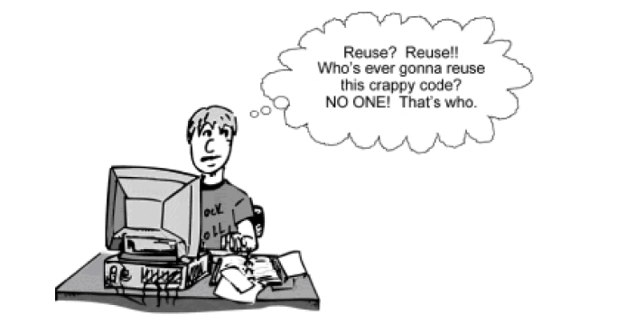
Root Cause of Anti-Patterns: Apathy

Slide 55
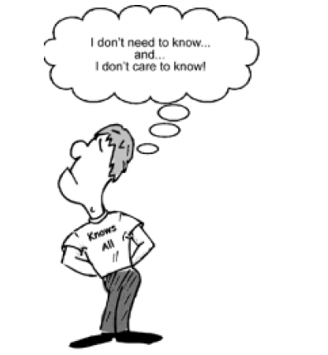
Root Cause of Anti-Patterns: Narrow-Mindedness

Slide 56
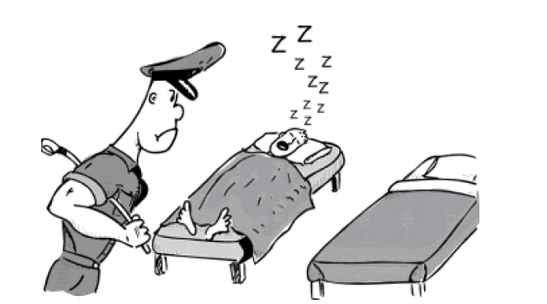
Root Cause of Anti-Patterns: Sloth

Slide 57
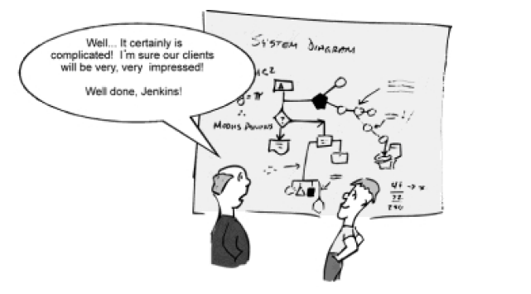
Root Cause of Anti-Patterns: Avarice

Slide 58
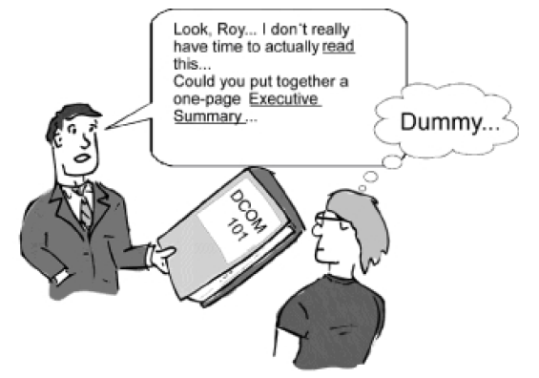
Root Cause of Anti-Patterns: Ignorance

Slide 59

Root Cause of Anti-Patterns: Pride

Slide 60
Anti-Pattern
Software design anti-patterns
Object-oriented design anti-patterns
Project management anti-patterns
Organizational anti-patterns

Slide 61
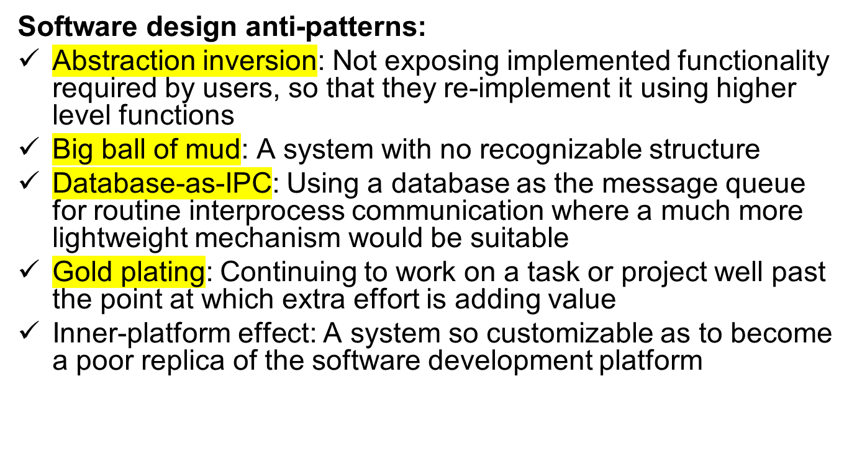
Anti-Pattern

Slide 62
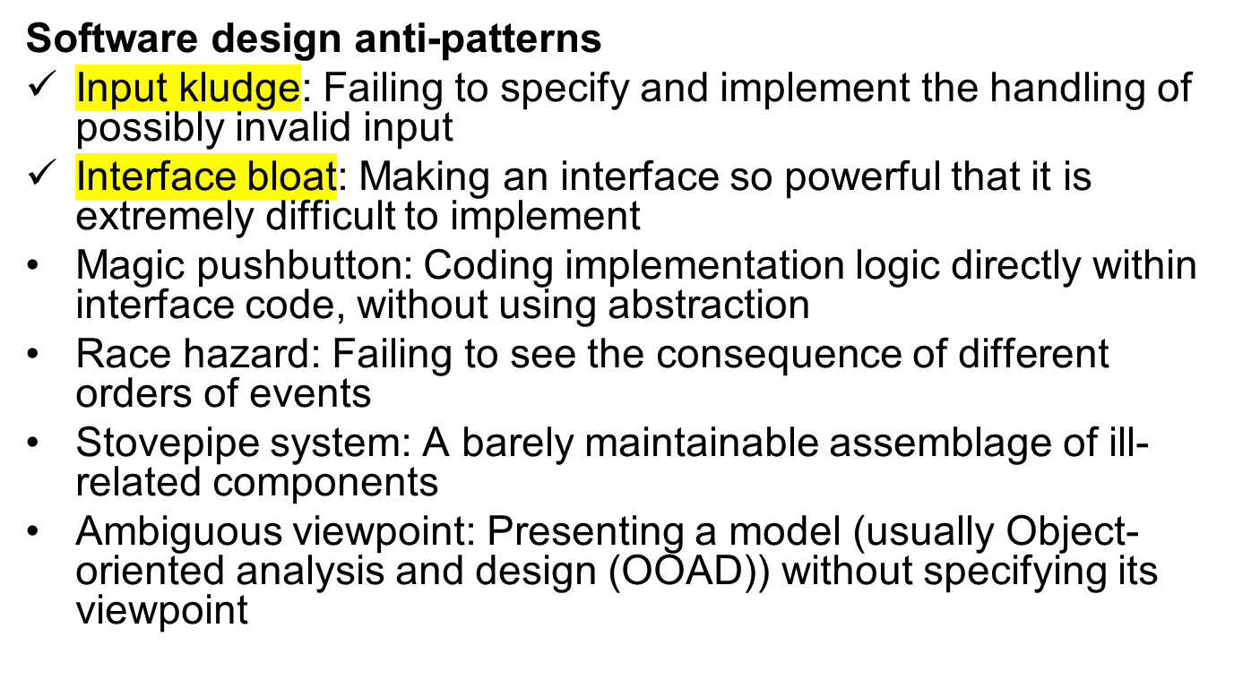
Anti-Pattern

Slide 63
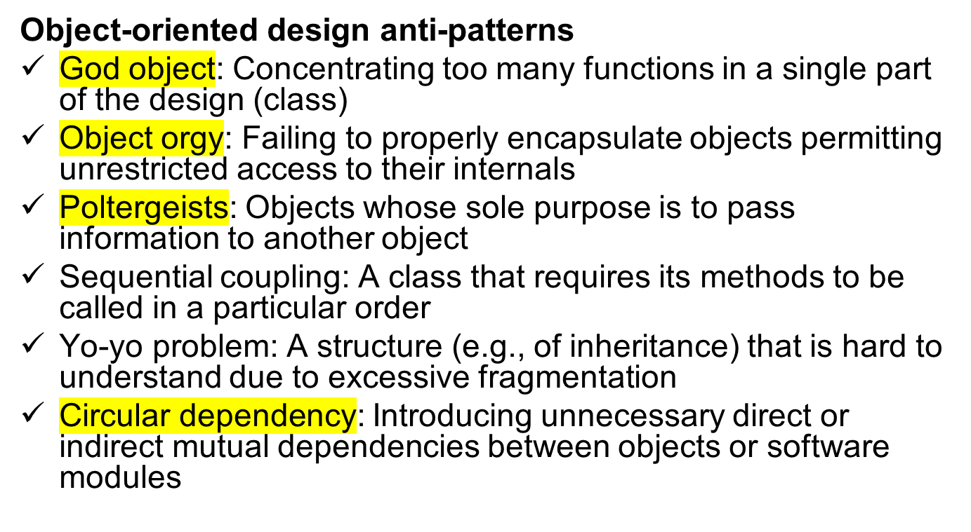
Anti-Pattern

Slide 64
Anti-Pattern
Object-oriented design anti-patterns
Call super: Requiring subclasses to call a superclass's overridden method
Circle-ellipse problem: Subtyping variable-types on the basis of value-subtypes
Constant interface: Using interfaces to define constants
Object cesspool: Reusing objects whose state does not conform to the (possibly implicit) contract for re-use
BaseBean: Inheriting functionality from a utility class rather than delegating to it
Anemic Domain Model: The use of domain model without any business logic. The domain model's objects cannot guarantee their correctness at any moment, because their validation and mutation logic is placed somewhere outside (most likely in multiple places).

Slide 65
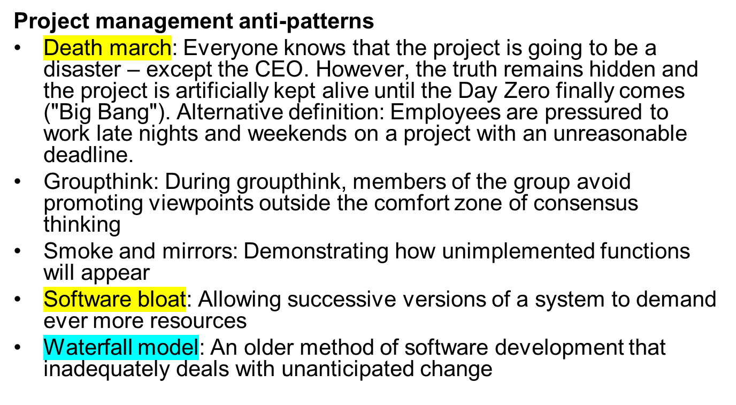
Anti-Pattern

Slide 66
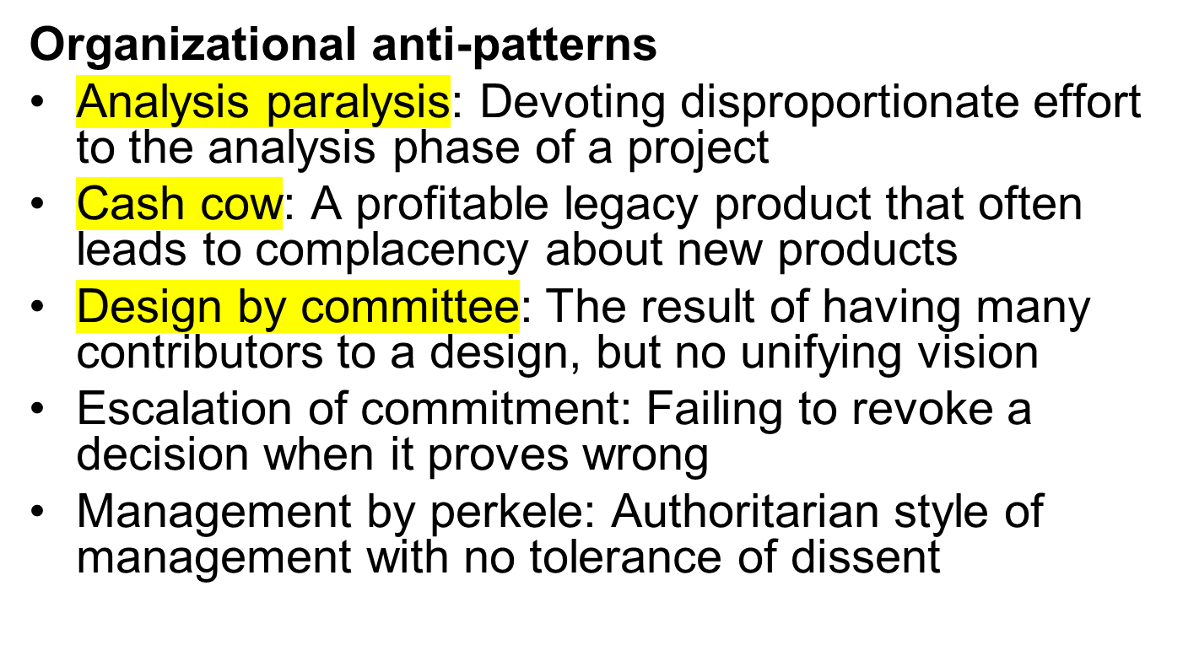
Anti-Pattern

Slide 67
Anti-Pattern
Organizational anti-patterns
Matrix Management: Unfocused organizational structure that results in divided loyalties and lack of direction
Moral hazard: Insulating a decision-maker from the consequences of his or her decision
Mushroom management: Keeping employees uninformed and misinformed (kept in the dark and fed manure)
Stovepipe or Silos: A structure that supports mostly up-down flow of data but inhibits cross organizational communication
Vendor lock-in: Making a system excessively dependent on an externally supplied component

Slide 68
Why Study AntiPatterns?
Provide a method of efficiently mapping a general situation to a specific class of solutions
Provide real world experience in recognizing recurring problems in the software industry
Provide a common vocabulary for identifying problems and discussing solutions.

Slide 69
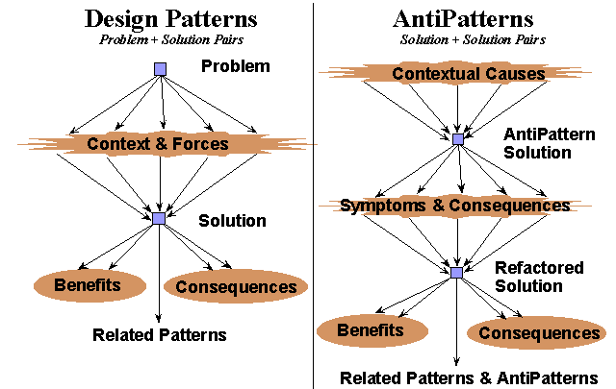
The Reference Model
From: http://www.antipatterns.com

